Slide 1


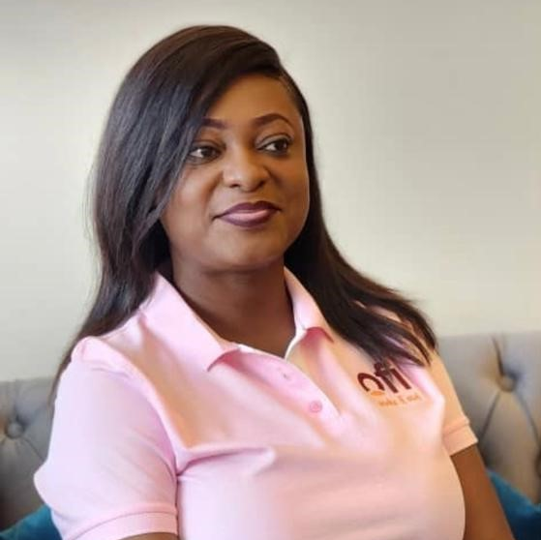
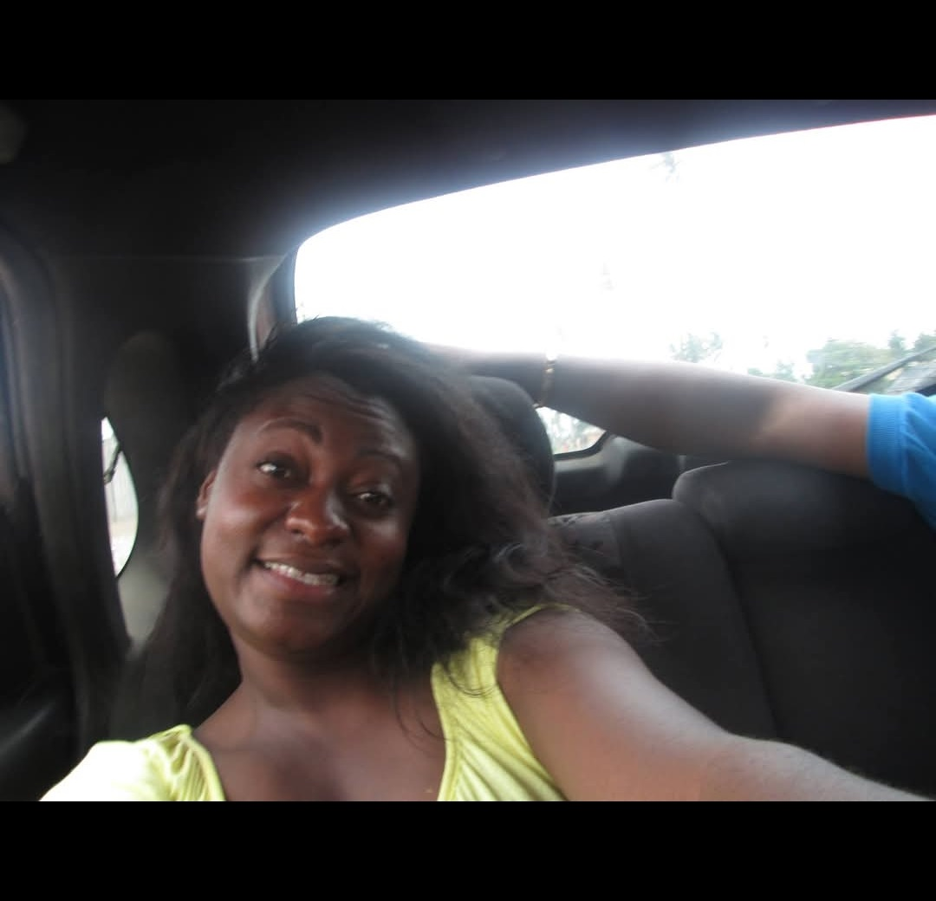
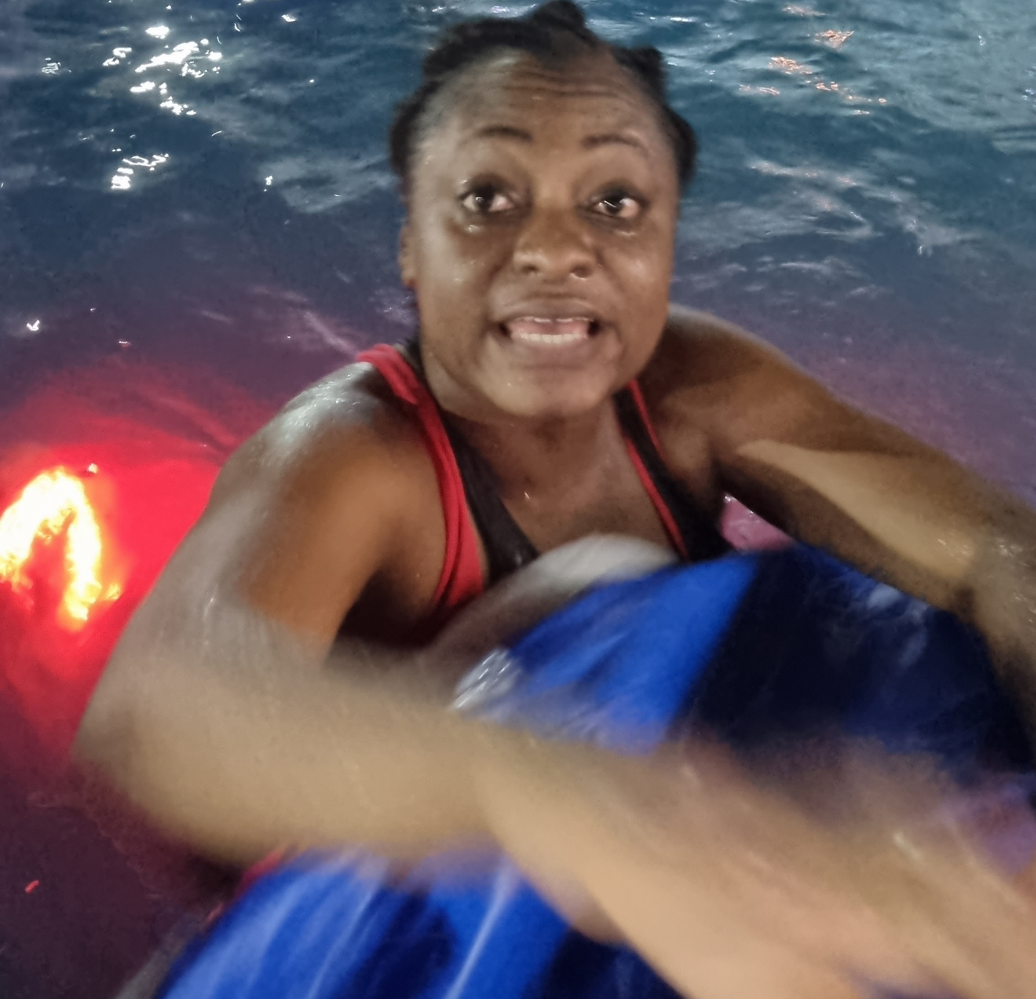
Getting to Know Me
Work
Personal
My role
Supply Chain Manager
Significant others / family members / furry friends in my life
Frank Kwaku Doku/ Arielle Doku/ Adutwumwaa, Adobea, Naa Knox
Tenure in ofi/Olam
13 years
How I enjoy spending my free time
Family time,Having a good laugh
Previous companies I have worked at
Republic Bank Ghana Limited
ADM,Milwaukee U.S.A
ADM, Kumasi
My favorite / comfort food
Salads
Why I joined ofi/Olam and what keeps me here?
Acquisition of ADM by Olam
My favorite song
Our God- Chris Tomlin
Stella Owusu-Ansah
‘Stella’
I enjoy music
I enjoy comedy
This is me outside work, doing stuff I enjoy in my life …

